Slide 1
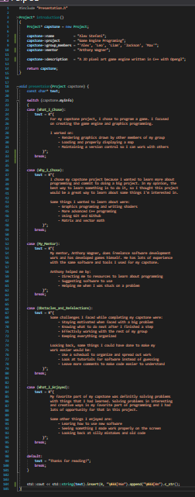


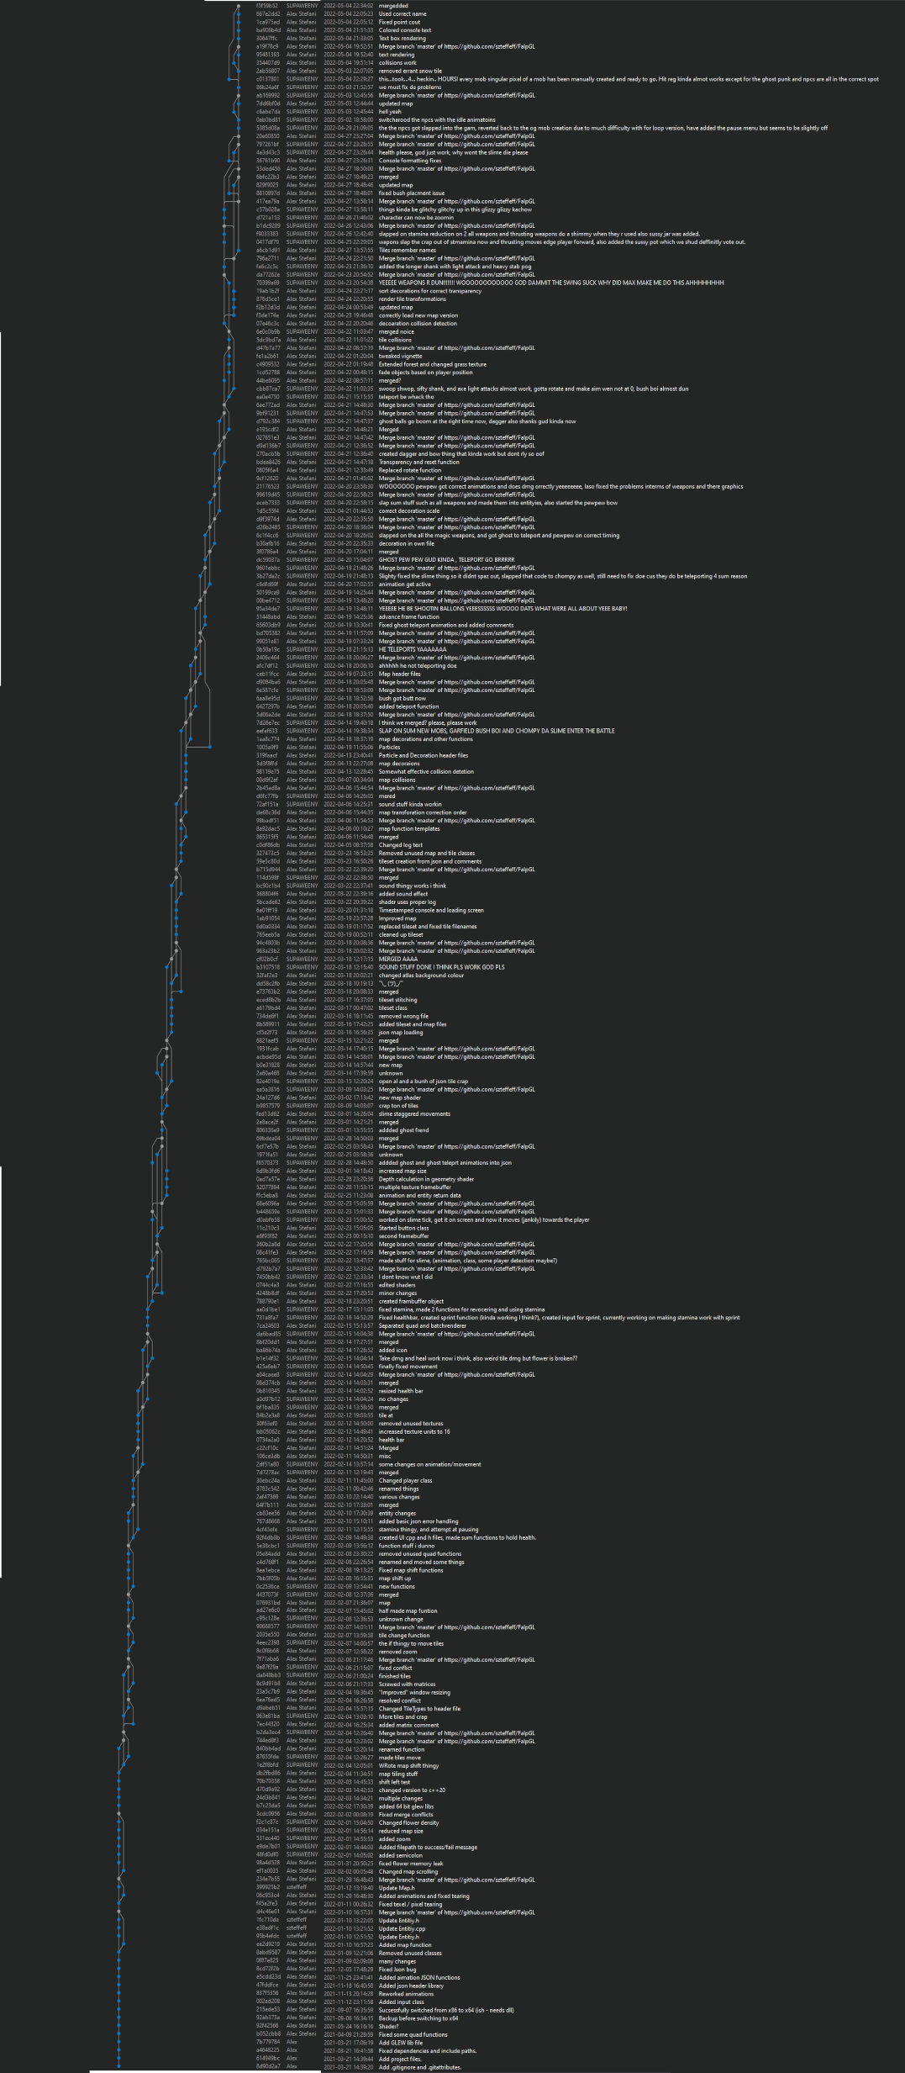












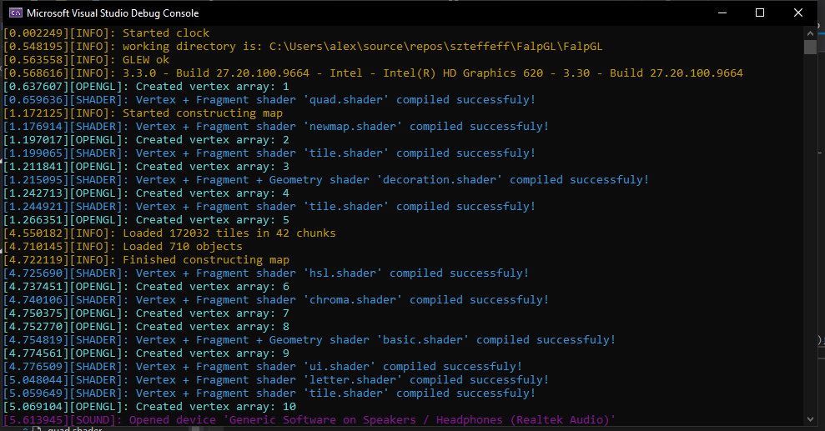
Programming
OpenGL: Video rendering library
Microsoft Visual Studio: IDE
GLM:
OpenGL math library
GLEW:
Graphics library extinction
wrangler
GLFW:
Window API
C++: Programing language
OpenAL: Audio rendering library
Github: Git repository host
GIMP: Image Editor
Git: Version control software
sndfile: Audio reading and writing
Tiled: Map editor
Notepad++: Text editor

